Slide 1

A glance into US Healthcare Expenditures & Health Outcomes
Sam
Sims
Nurmaa
Dashzeveg
Kathryn
McAtee
Fran
Ruiz

Slide 2




Meet The Outliers
Kathryn McAtee
Project Manager
Data Analyst & Developer
Background: CPG and Pharma IT
Fran Ruiz
Presentation Development
Data Analyst & Developer
Background: Instructional design & systems engineering
Nurmaa Dashzeveg
Data Analyst & Developer
Background: Data & Cancer Research
Sam Sims
Data Analyst & Lead Developer
Background: Technology End User Operations

Slide 3
Agenda
Meet the Team
Introduction to the Project & the Question to be Answered
Our Hypothesis
The Outliers at Work: Analysis
How our Analysis Measured Up
Lessons Learned

Slide 4
Intro & Questions to be Answered
US Healthcare spend continues to increase year over year¹ and projections are not slowing down.
Is the personal healthcare investment making a positive impact on health? And does that answer change based on where you live, how much you make, if you receive government assistance, or where all of that spend is being allocated? Is the US personal healthcare investment connected to a positive mortality outcome?
Is the investment worth it?

Slide 5
Hypothesis
The Outliers believe that
the average American is paying more for healthcare than they were in previous years, but the value of the investment is declining year over year.
We believe the rate of increase does NOT correlate to mortality outcomes.
¹
https://www.healthsystemtracker.org/chart-collection/u-s-spending-healthcare-changed-time/
https://www.statista.com/statistics/184955/us-national-health-expenditures-per-capita-since-1960/

Slide 6
Areas to Analyze
Presenter:
1. Demonstrate the healthcare expenditure over the year (2010-2017)
2. The total healthcare spend in government programs.
3. The relation between total population and enrollment in Medicare between
2010 to 2017 in the US.
5. The statistics of mortality rates and healthcare spend.
4. The relation of high-income earners population and healthcare spend.
Sam
Kathryn
Fran
Nurmaa
Sam

Slide 7
1. Demonstrate the healthcare expenditure over the year (2010-2017)
Analyst Sam Sims

Slide 8
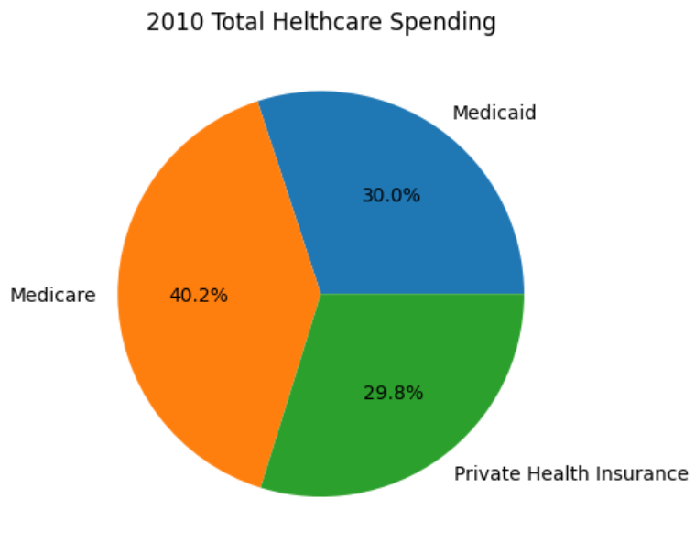
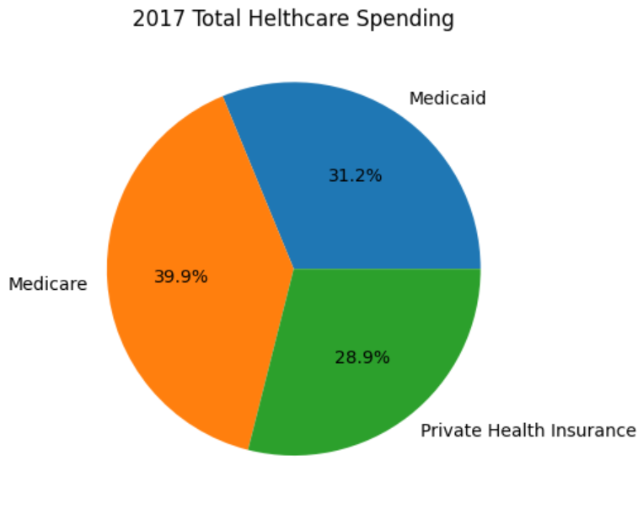
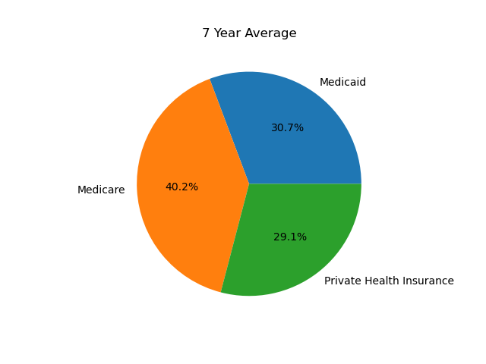
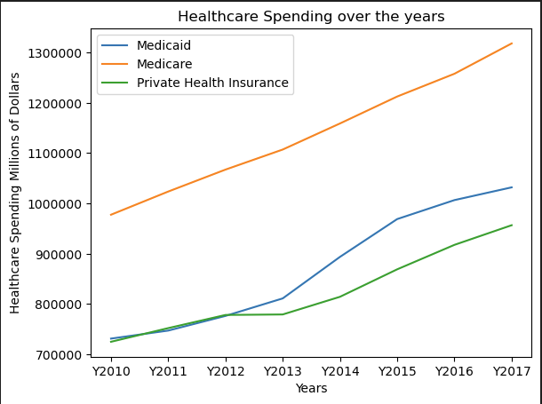
Overview of total US spending 2010-2017: Medicare, Medicaid, and Private Insurance
-Those on gov’t programs get more assistance, but do not spend less on healthcare
---though personally

Slide 9
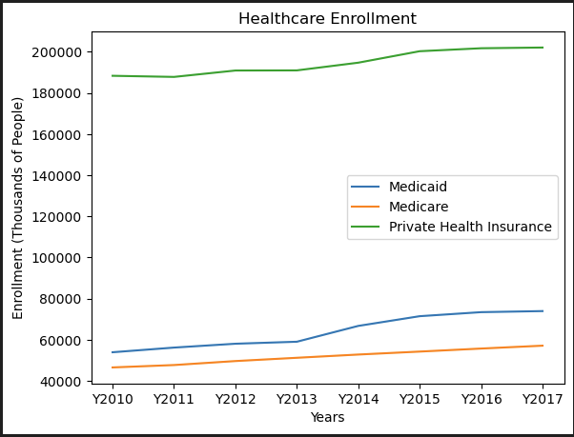
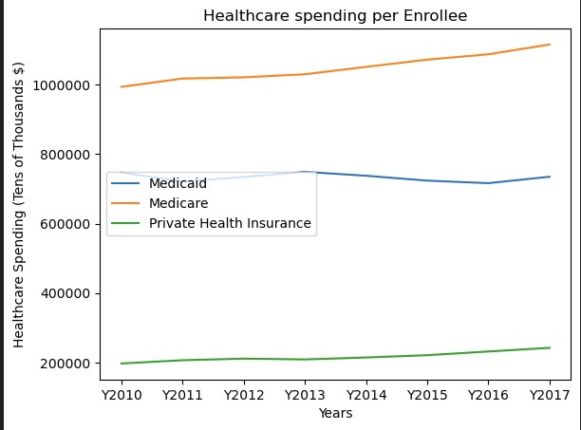
Comparison of Enrollment and spending per Enrollee

Slide 10
A look into government healthcare program personal spend.
Analyst Kathryn McAtee

Slide 11
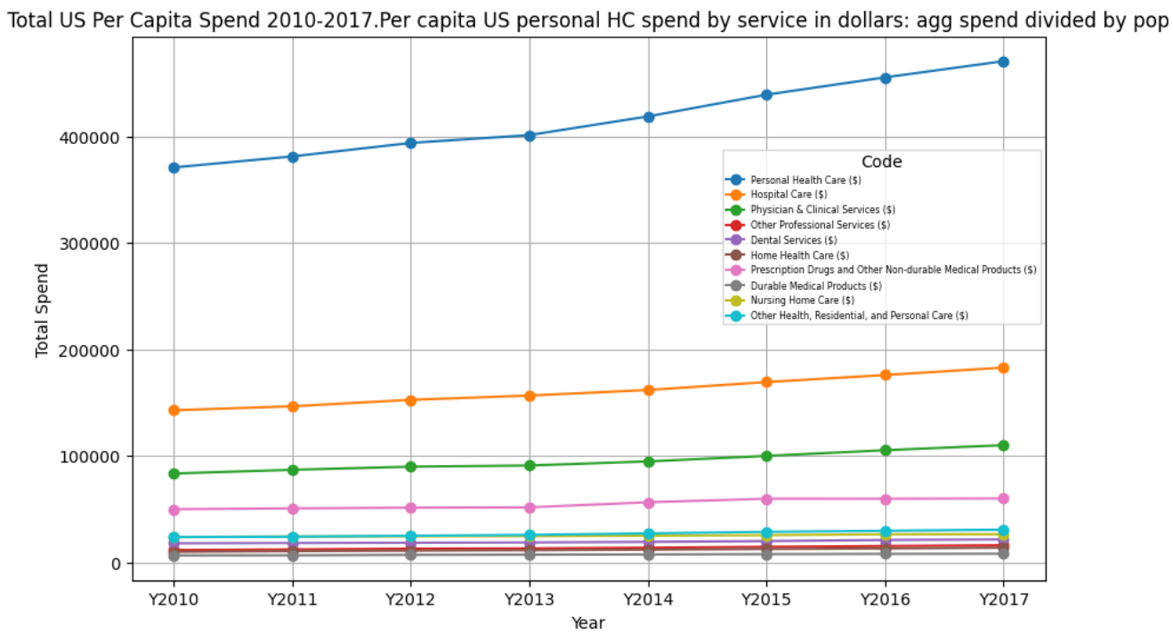













Healthcare Spend is Increasing
Personal
Health Care
Hospital
Care
Physician &
Clinical Services
Other
Professional
Services
Dental
Services
Home Health
Care
Prescription
Drugs
Durable
Medical
Products
Nursing
Home Care
Other
Health Care
Population/
Enrollment
1
2
3
4
5
6
7
8
9
10
11
Notes:
Medicare Agg - Total Medicare personal health care spending by state and by service, 2010-2017
Medicaid Agg - Total Medicaid personal health care spending by state and by service, 2010-2017
PHI Agg - Total private health insurance personal health care spending by state and by service, 2010-2017
HC is getting more expensive and spend is increasing year over year – no surprise there. But rather than total spend, we want to see where the spend was increasing.
This chart shows the total per capita US Healthcare spend divided by the population for years 2010-2017.

Slide 12
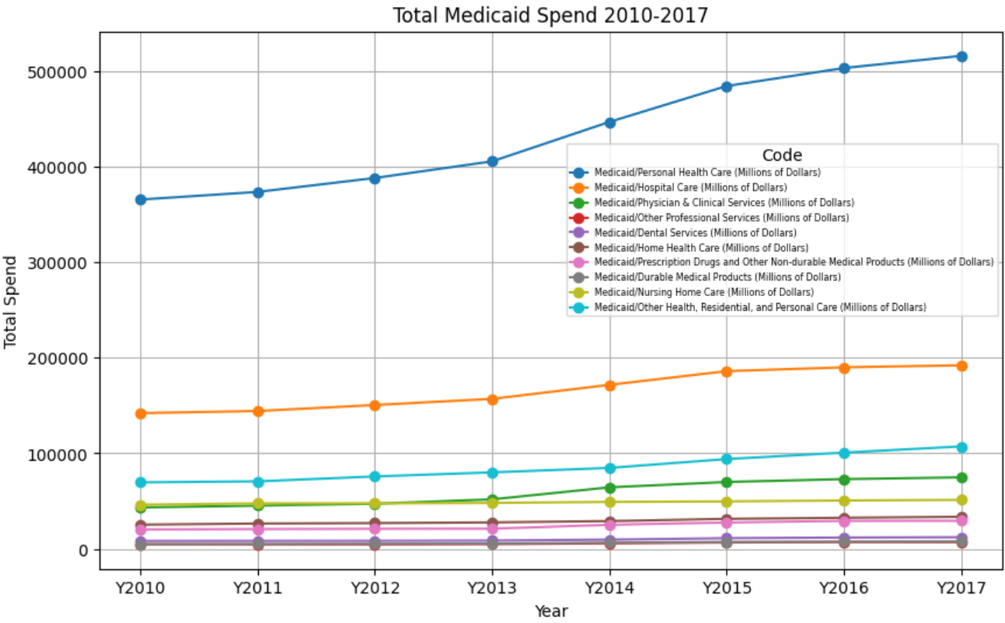
Medicaid Increases by Service and Year
Personal
Health Care
Hospital
Care
Physician &
Clinical Services
Other
Professional
Services
Dental
Services
Home Health
Care
Prescription
Drugs
Durable
Medical
Products
Nursing
Home Care
Other
Health Care
Population/
Enrollment
1
2
3
4
5
6
7
8
9
10
11
Notes:
With personal health spend increasing, we wanted to look to see if we saw the same trend in gov program spending
Not only do you see the same upward trend, you can see sharper increases on Medicaid starting around 2014 (for those who need the extra financial support) vs. those on Medicare (those 65 & older) – Medicare is also increasing but at a steady pace.

Slide 13
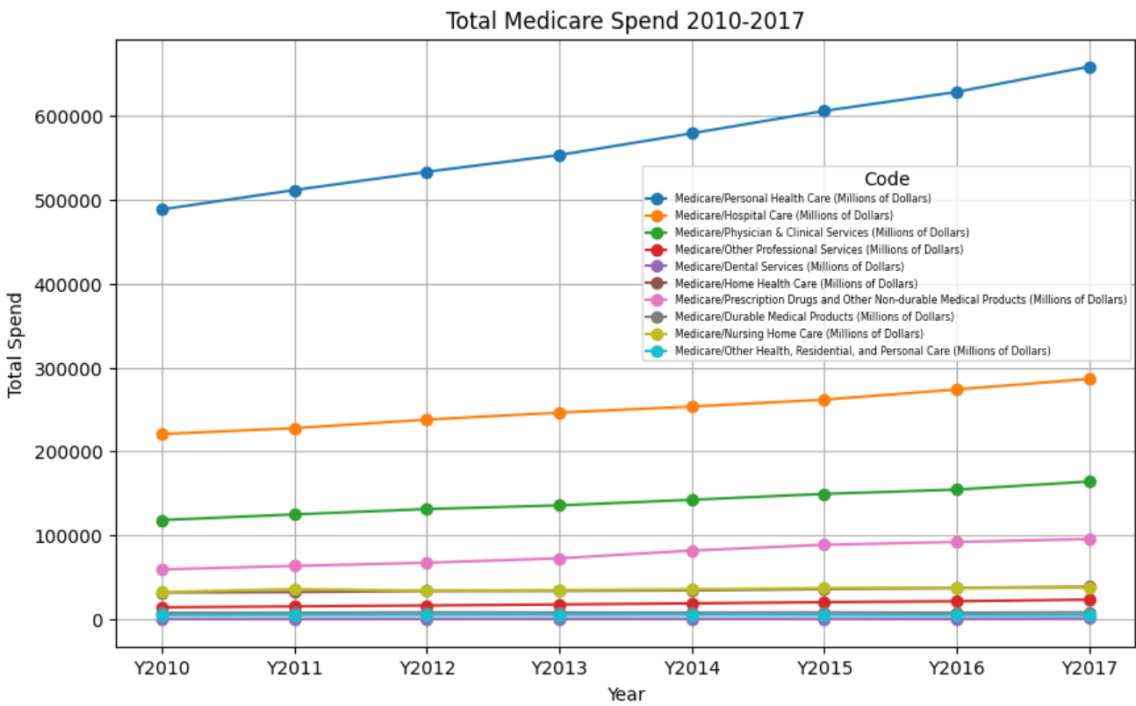
Medicare Increases by Service and Year
Personal
Health Care
Hospital
Care
Physician &
Clinical Services
Other
Professional
Services
Dental
Services
Home Health
Care
Prescription
Drugs
Durable
Medical
Products
Nursing
Home Care
Other
Health Care
Population/
Enrollment
1
2
3
4
5
6
7
8
9
10
11
Notes:
With personal health spend increasing, we wanted to look to see if we saw the same trend in gov program spending
Not only do you see the same upward trend, you can see sharper increases on Medicaid starting around 2014 (for those who need the extra financial support) vs. those on Medicare (those 65 & older) – Medicare is also increasing but at a steady pace.

Slide 14
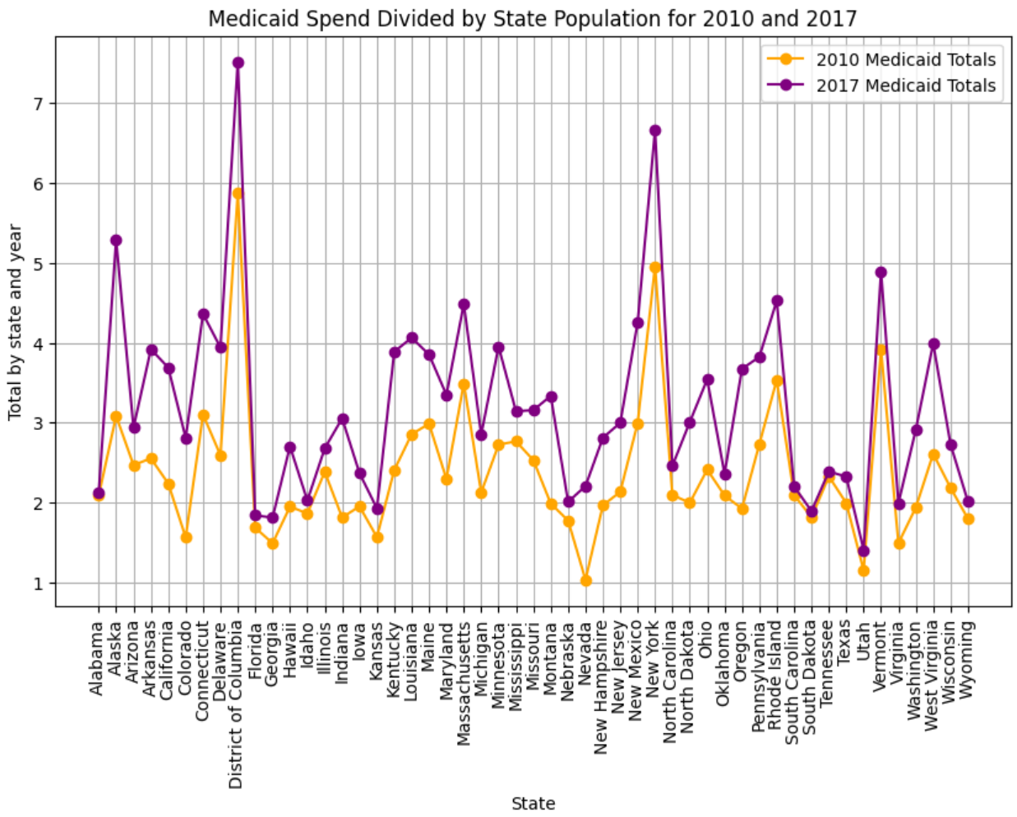
Medicaid Spend Divided by State Population
Notes:
If we go down a layer and look at the spend by state for government programs, you’ll notice both saw increases from 2010-2017, some states more than others, and you’ll see an overlay of mortality in a few slides in order to find if there was correlation with the spend you see here, but
key call out is that Medicaid is actually seeing a higher spend than Medicare,
though Medicare is seeing sharper increases year over years
One thing we wanted to look into that proved challenging because we didn’t have the data we needed to do it – there would be too many assumptions in the data we had, was overlay those on Medicare and Medicaid – if you’re on Medicare, there’s a chance you could be on Medicaid, but if you’re on Medicaid, it doesn’t necessarily mean you’re on Medicare.

Slide 15
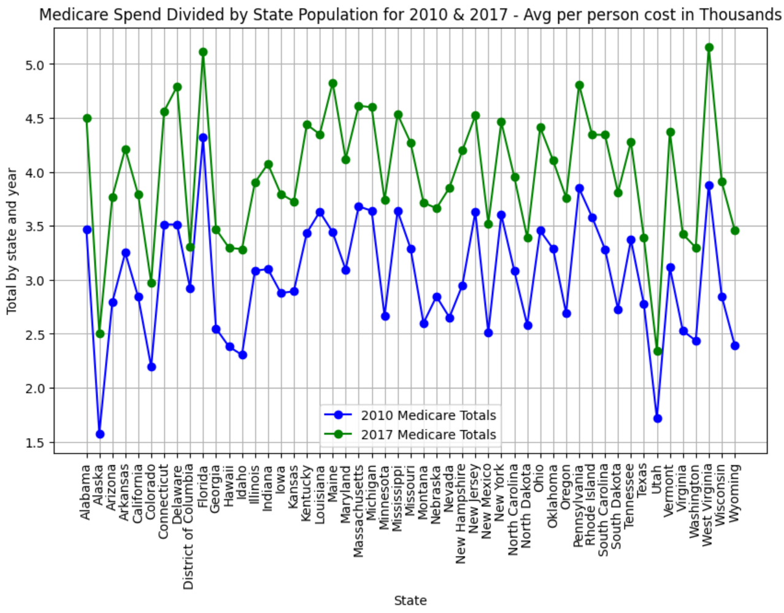
Medicare Spend Divided by State Population
Notes:
If we go down a layer and look at the spend by state for government programs, you’ll notice both saw increases from 2010-2017, some states more than others, and you’ll see an overlay of mortality in a few slides in order to find if there was correlation with the spend you see here, but
key call out is that Medicaid is actually seeing a higher spend than Medicare,
though Medicare is seeing sharper increases year over years
One thing we wanted to look into that proved challenging because we didn’t have the data we needed to do it – there would be too many assumptions in the data we had, was overlay those on Medicare and Medicaid – if you’re on Medicare, there’s a chance you could be on Medicaid, but if you’re on Medicaid, it doesn’t necessarily mean you’re on Medicare.

Slide 16
3. The relation between total population and enrollment in Medicare between 2010 to 2017 in the US.
Analyst Fran Ruiz

Slide 17
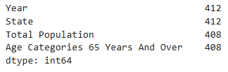
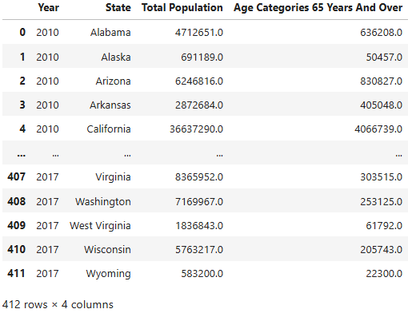
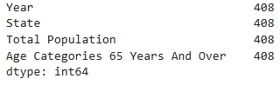
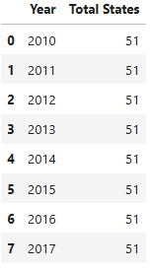
Data Set 1
count_states.count()
new_census_data.dropna()
new_census_data

Slide 18
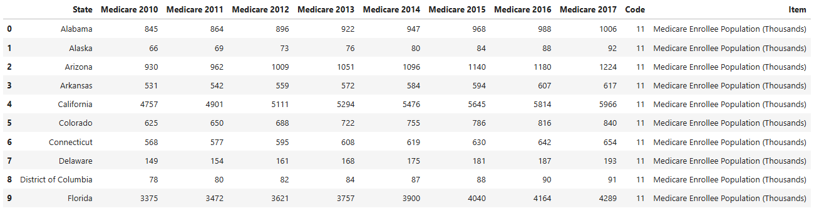
Data Set 2
medicare_data.head(10)

Slide 19
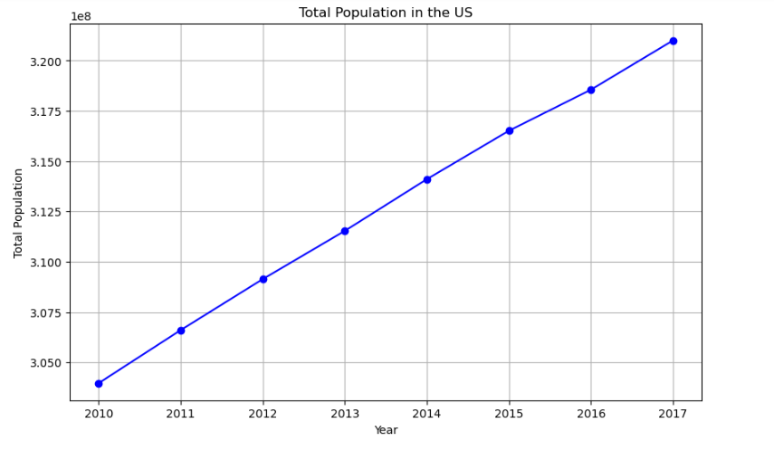
Total Estimate Population in The US from 2010 to 2017

Slide 20
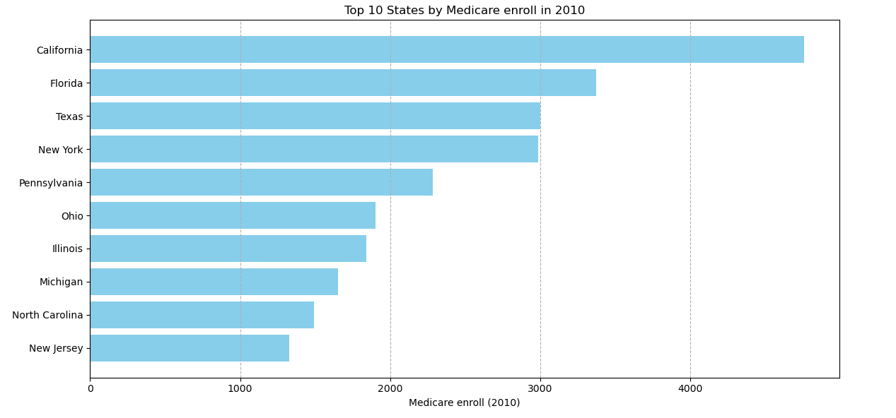
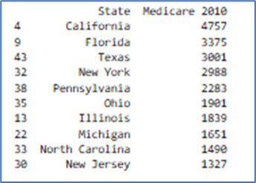
Top ten states by Medicare enroll in 2010
nlargest()

Slide 21
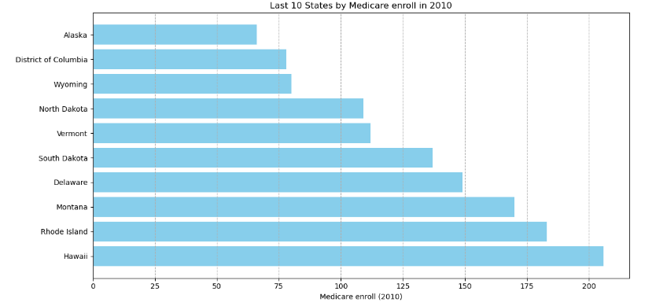
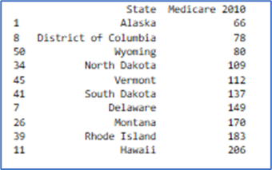
The last ten states by Medicare enroll in 2010
Nsmallest()

Slide 22
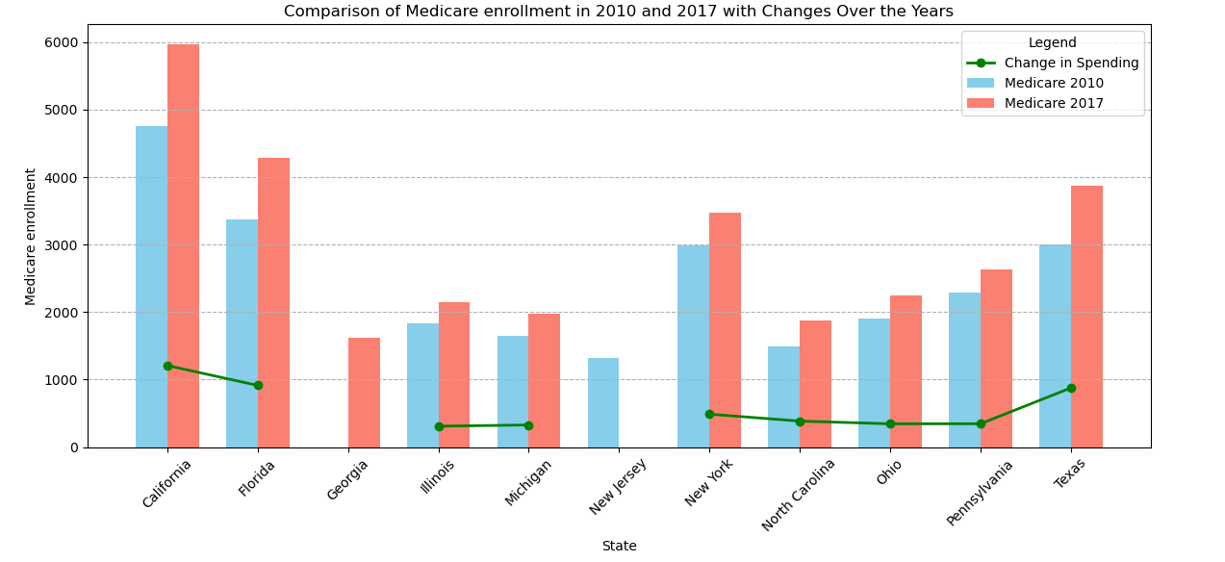
Top ten states by Medicare enroll in 2010 and 2017
nlargest()

Slide 23
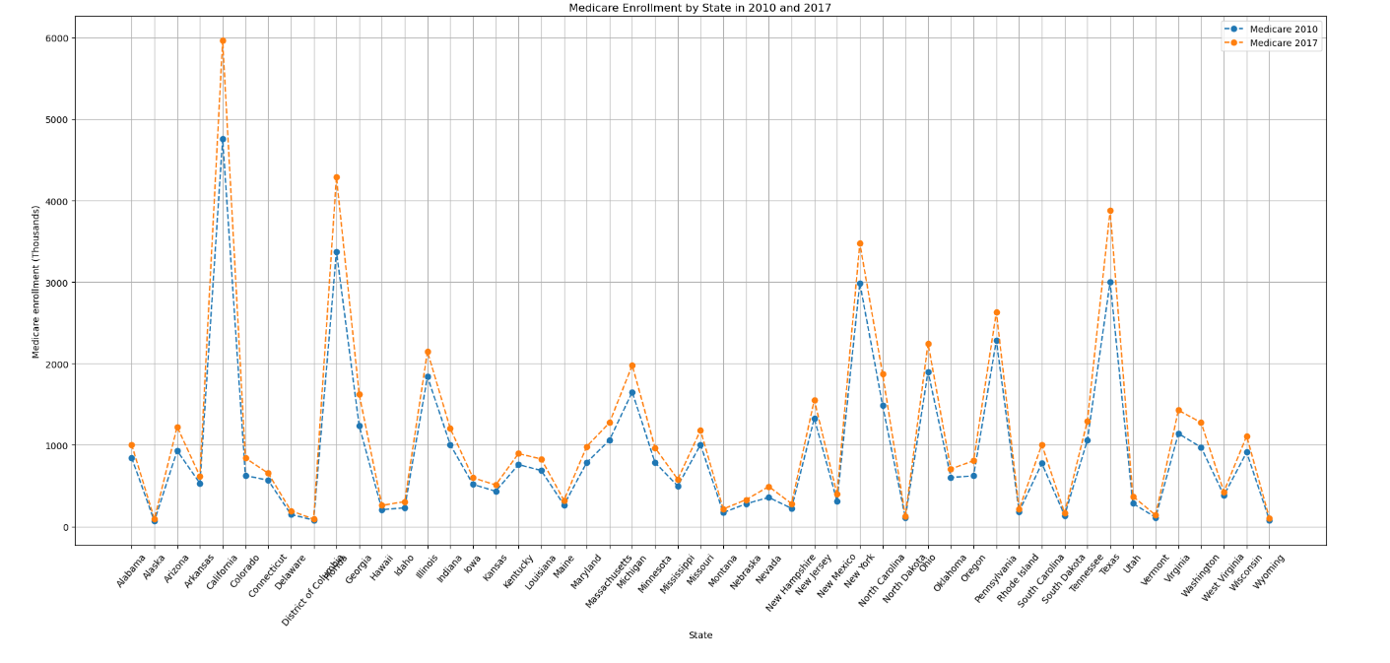
Medicare Enrollment in the US per State

Slide 24
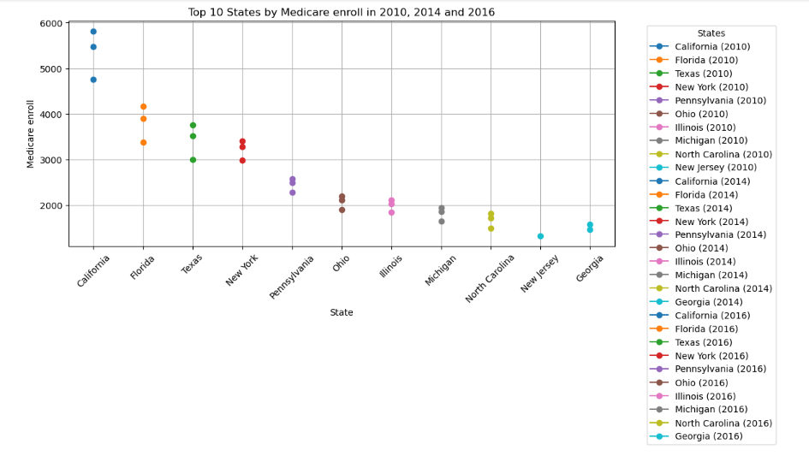
Top Ten States by Medicare Enrollment in 2010, 2014 and 2017

Slide 25
4. The relation of high-income earners population and healthcare spend.
Analyst Nurmaa Dashzeveg

Slide 26
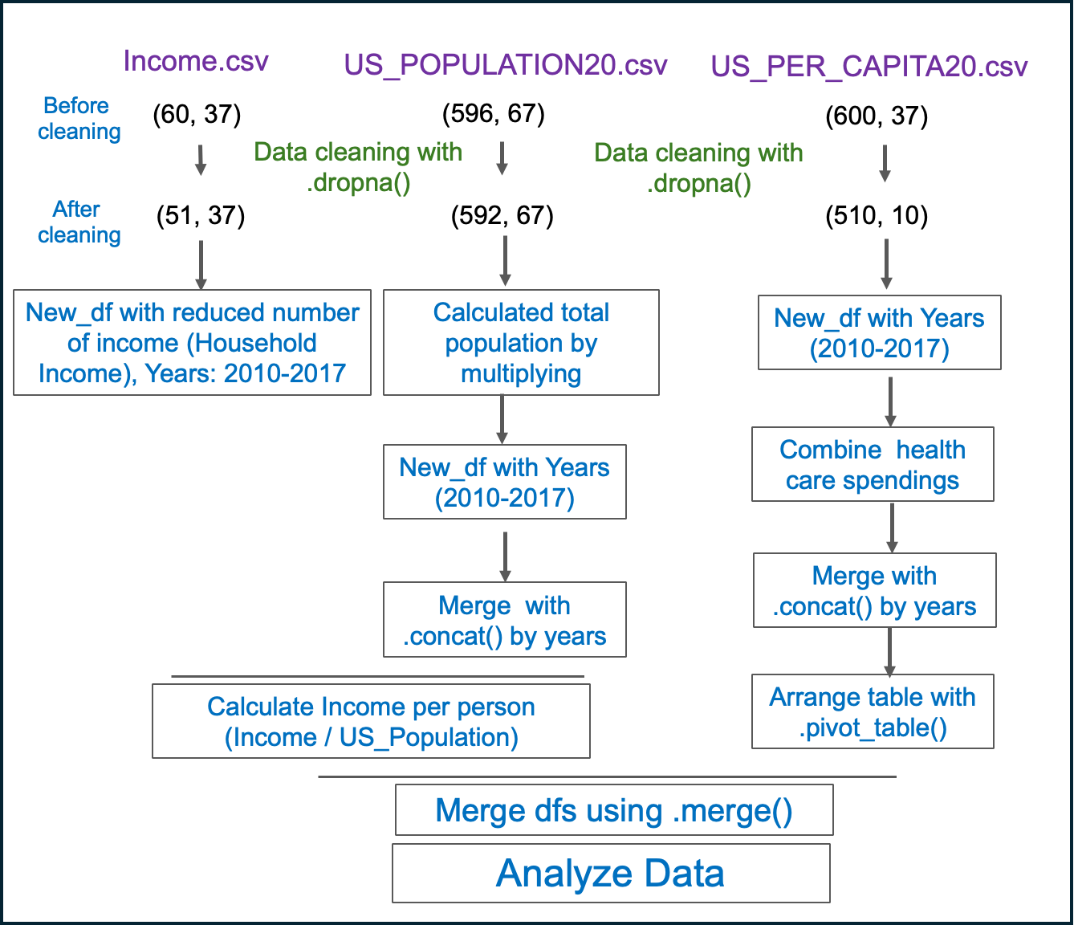
Strategy of data analysis
Hypothesis:
Do wealthier populations (by state) invest more in health care?

Slide 27
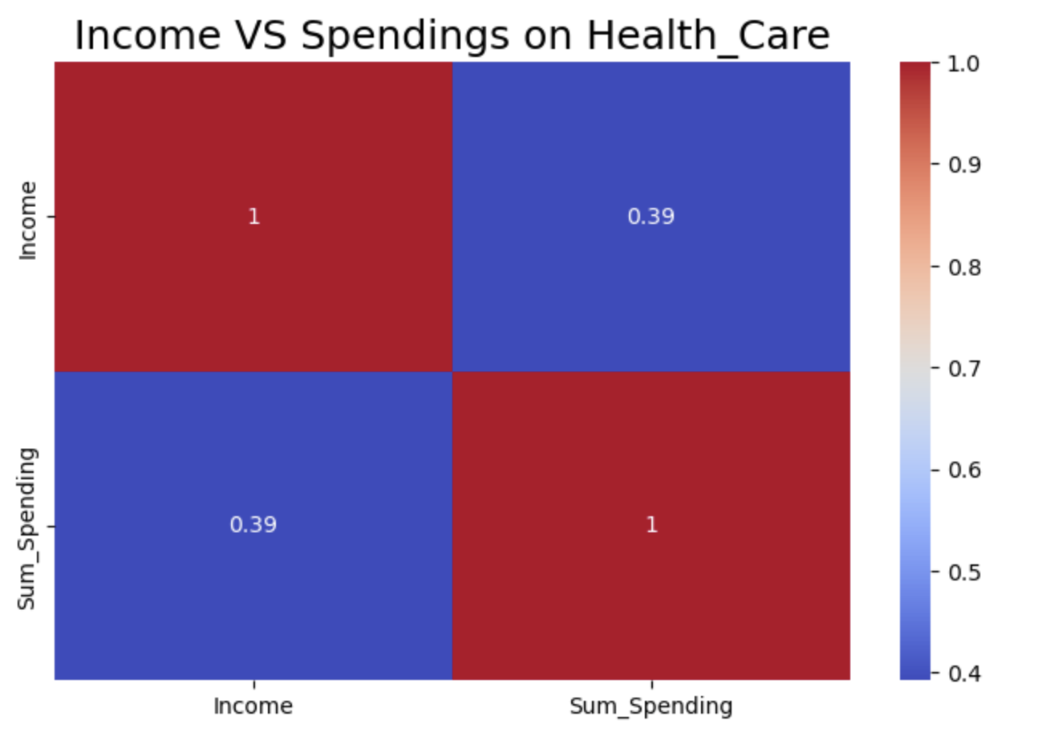
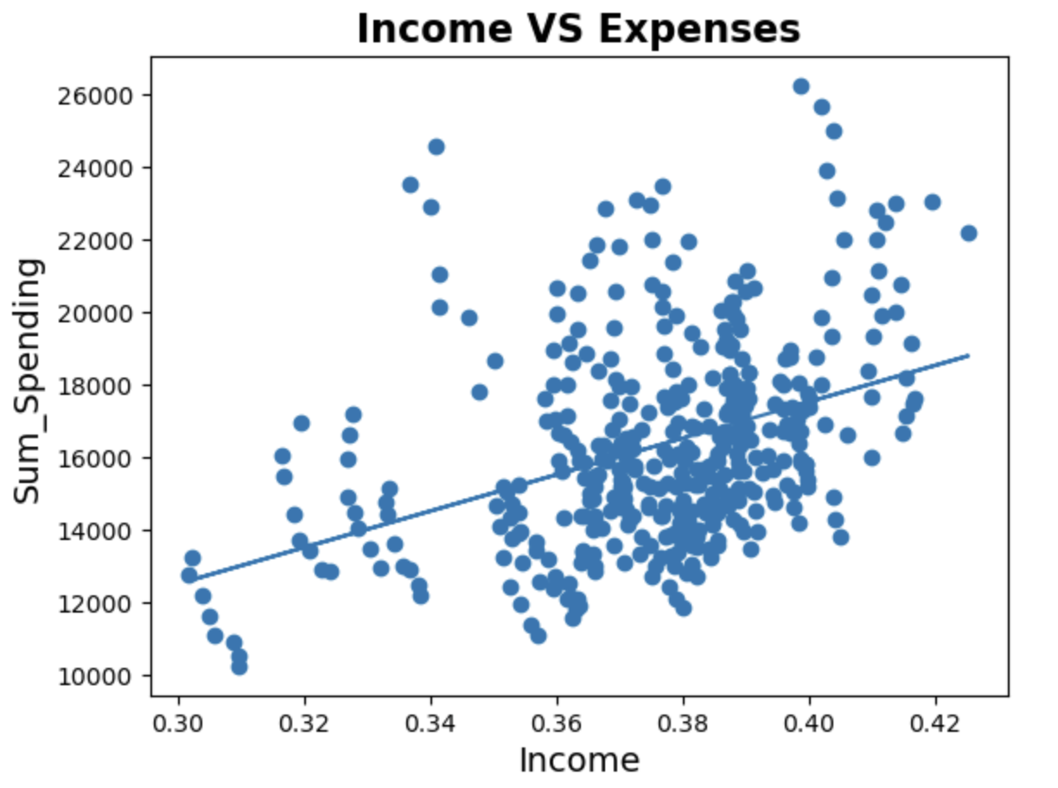
Correlation in between Income and Health Care Expenses
R=0.3959
P=1.88e-16
Income and health care expenses have mild positive correlation.

Slide 28
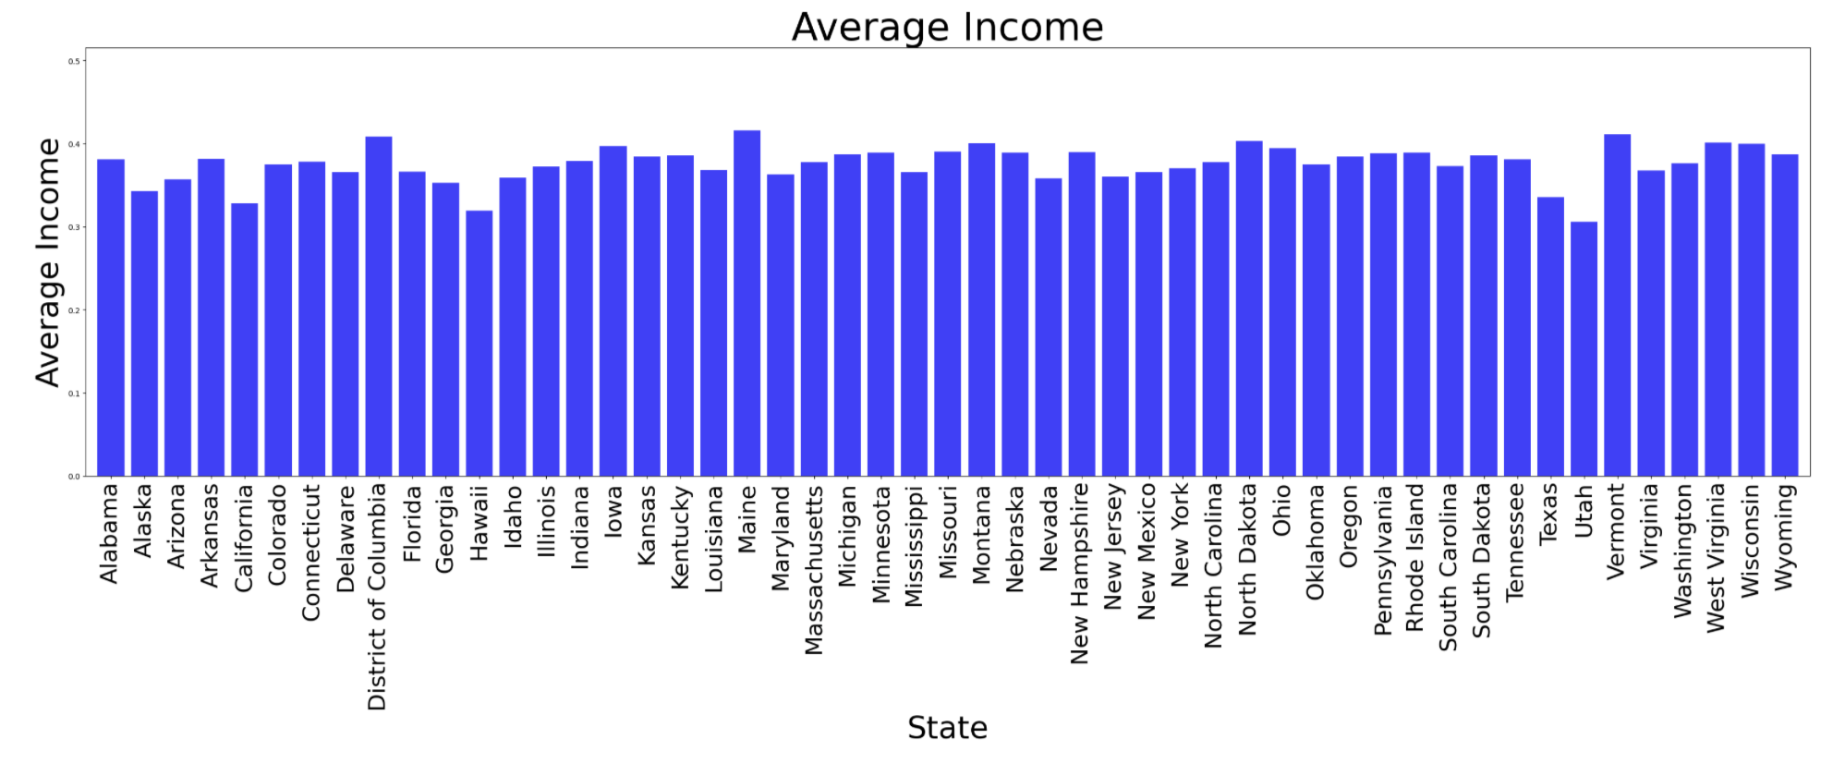
Average Income by States
Slightly high
Slightly high
It might there are very big variations in California
Lowest Income

Slide 29
5. The statistics of mortality rates and healthcare spend.
Analyst Sam Sims

Slide 30
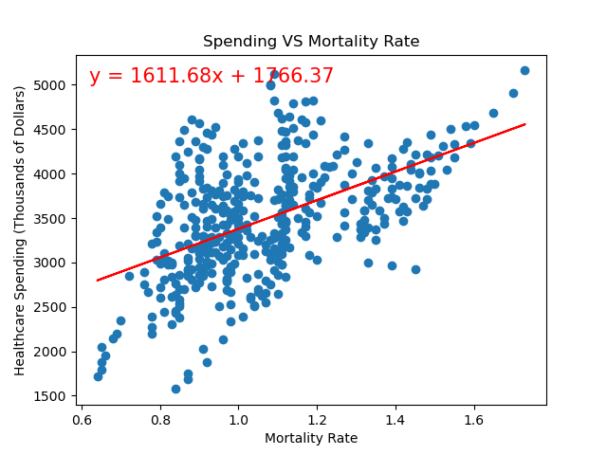
Mortality VS Per Capita Spending
R^2 .267

Slide 31
Revisiting Our Key Questions
Is the US personal healthcare investment connected to a positive mortality outcome?
Is the investment worth it?
The data shows that increased healthcare investment does not lead to better mortality outcomes – so, in the context of this analysis, our team was accurate in our prediction that higher health spend is not positively correlated to a better mortality rate.
Though the Outliers Hypothesis turned out to be true, we do believe the investment is worth it, though not in the sole context of mortality rate.

Slide 32
Lessons Learned
Project Learnings
We took on too much of a challenge for our first project; need to remember less is more.
It all starts with the data. We quickly realized the importance of finding a good, solid data set would make all of our lives easier. The quality of the data supersedes the quality of the idea itself.
Without proper data cleaning, the analysis could have led to inaccurate insights, such as misrepresenting population or Medicare enrollment trends due to faulty or missing data.
Where libraries exist – use them over manipulating CSVs!
Do more pushes and pulls more often to keep things in sync and avoid duplicating work.
Understand the question/hypothesis well before starting data collection and analysis and think logically to analyze data, there are thousands of ways to analyze data.
Be Friends with Google!
Group Learnings
With such a short timeframe to deliver, we quickly realized we needed to lean on each other’s strongest skills to deliver.
We saw the benefit of quickly selecting an idea with a ‘good enough’ data set, despite a few challenges along the way. Staying organized and having good communication as a team contributes just as much to the success of the project as the code itself.

Slide 33
Thank you
The Outliers Team

Slide 34
Project Requirements
Readme File
Jupyter Notebook
*1 comprehensive & consolidated notebook for the group
Final Report
*between 12-15 pages
Presentation & Slides
Total time duration 5 min x # of team members (20~25 minutes) Followed by 15 minutes of Q/A
Must have Complete information of your project.
Team members.
Introduction of the project.
What does it do?
Who is the audience?
What problem does it solve
Where did the data come from?
instructions on how to use your software
If anything needs to be installed ( instructions on packages/libraries, API-Keys etc)
Make sure the cells are clean and clear with lots of comments.
Data joins and data cleanup should be properly explained and the findings be documented. Also do
After doing an EDA add a markdown cell to explain what you found out from the analysis.
Team members.
Introduction of the project.
What problem does it solve
What issues did you have while dealing with it
Did you join the data with another external source? Explain what you had to do.
Complete EDA with explanation.
Problems faced
Lessons learnt.
Any other wishlist.
1-3 introductory slides
Introduce the project
Who is the audience?
What problem does it solve?
All the questions. What is your Hypothesis?
Who are the team-members and what is their role
2-3 slides for each question. Supported by analysis and Visuals that are clear and well labeled
Lessons learnt
1 slide for Conclusion
NOTE: The main repo should have a directory called FinalProject1 with only these 4 files and a data directory with your csv file(s). If you are using your own .py files, please document them in README, the notebook and the final document.
There can be other directories for each team member with their individual work in the git repo.

